Slide 1
Computer Science
Gready Algorithms
Samuel Lukas

Slide 2
Introduction
A greedy algorithm is an algorithm that follows the problem solving heuristic of making the locally optimal choice or best choice at each stage with the hope of finding a global optimum.
In many problems, a greedy strategy does not in general produce an optimal solution, but nonetheless a greedy heuristic may yield locally optimal solutions that approximate a global optimal solution in a reasonable time.

Slide 3
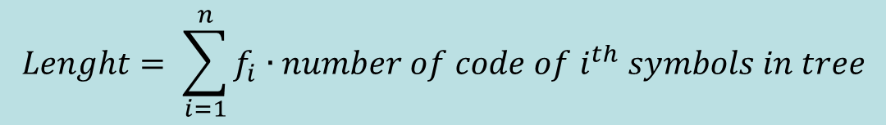
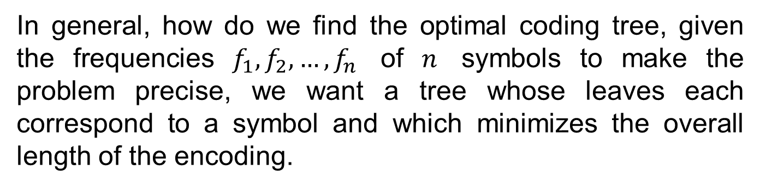
Huffman Code Problem
In general, how do we find the optimal coding tree, given the frequencies $f_{1},f_{2},…,f_{n}$ of $n$ symbols to make the problem precise, we want a tree whose leaves each correspond to a symbol and which minimizes the overall length of the encoding.
In thousand | A | B | C | D | E | F | Total
Frequencies | 45 | 13 | 12 | 16 | 9 | 5 | 100
3 Digits code | 000 | 001 | 010 | 011 | 100 | 101 | 300
Optimal coding | 1 | 010 | 011 | 000 | 0010 | 0011 | 224
$$Lenght= \sum_{i=1}^{n}{f_{i}}∙number of code of i^{th} symbols in tree$$

Slide 4
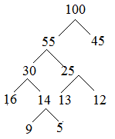
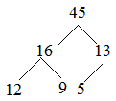
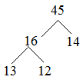
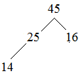


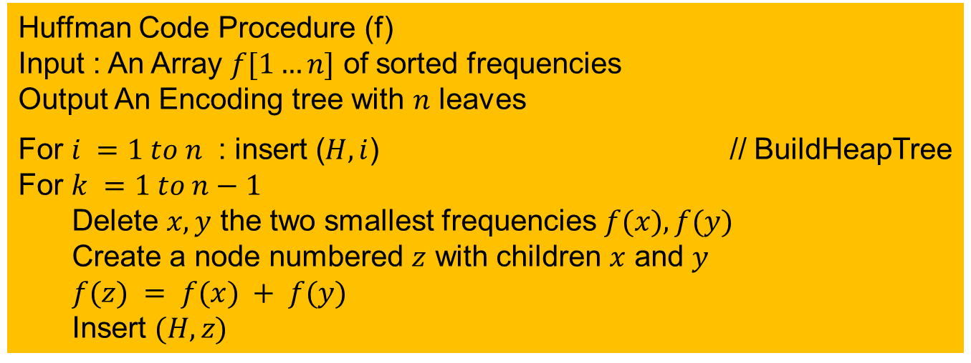
Huffman Code Procedure
Huffman Code Procedure (f)
Input : An Array $f[1…n]$ of sorted frequencies
Output An Encoding tree with $n$ leaves
For $i =1 to n$ : insert ($H,i$) // BuildHeapTree
For $k =1 to n−1$
Delete $x,y$ the two smallest frequencies $f(x), f(y)$
Create a node numbered $z$ with children $x$ and $y$
$f(z) = f(x) + f(y)$
Insert $(H,z)$

Slide 5
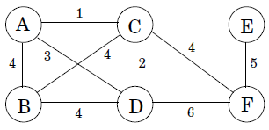
Minimum spanning trees
Suppose you are asked to network a collection of computers by linking selected pairs of them. This translates into a graph problem in which nodes are computers, undirected edges are potential links, and the goal is to pick enough of these edges that the nodes are connected.
But this is not all; each link also has a maintenance cost, reflected in that edge's weight. What is the cheapest possible network?

Slide 6
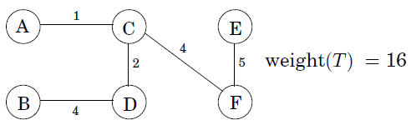
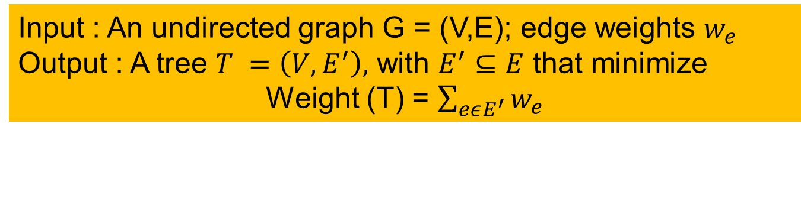
Formal Problem Formulation
The solution must be connected and acyclic: undirected graphs of this kind are called trees. The particular tree we want is the one with minimum total weight, known as the
minimum spanning tree.
Input : An undirected graph G = (V,E); edge weights $w_{e}$
Output : A tree $T =\left(V,E^{′}\right),$ with $E^{′}⊆E$ that minimize
Weight (T) = $\sum_{eεE^{′}}{w_{e}}$
This is not the only solution, can you find another

Slide 7
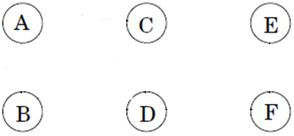
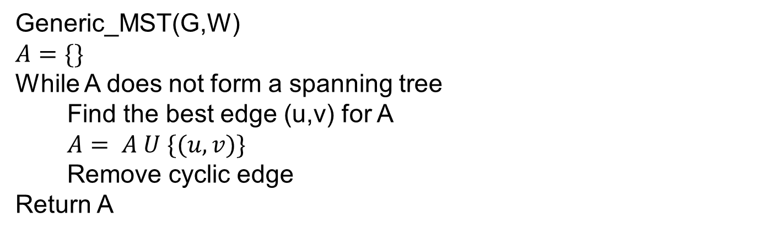
Gready Algorithms
This is a greedy algorithm: every decision it makes, is the one with the most obvious immediate advantage
Generic_MST(G,W)
$$A=\{\}$$
While A does not form a spanning tree
Find the best edge (u,v) for A
$A= A U \{(u,v)\}$
Remove cyclic edge
Return A
1
2
4
5
4

Slide 8
Exercise 01
Find the minimal Spanning Tree of this graph
8
7
b
c
d
4
2
9
4
14
a
i
e
11
8
7
6
10
h
g
f
Total is 37
1
2

Slide 9
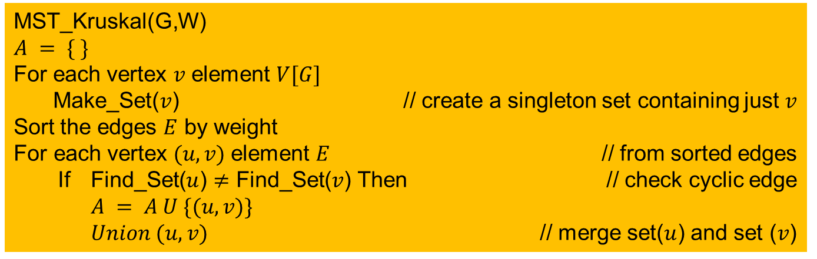
Kruskal Algorithms for MST
MST_Kruskal(G,W)
$$A = \{ \}$$
For each vertex $v$ element $V[G]$
Make_Set($v$) // create a singleton set containing just $v$
Sort the edges $E$ by weight
For each vertex $(u,v)$element $E$ // from sorted edges
If Find_Set($u$) $≠$ Find_Set($v$) Then // check cyclic edge
$A = A U \{(u,v)\}$
$Union (u,v)$ // merge set($u$) and set ($v$)
Make_Set($v$) is a procedure to create a singleton set containing just $v$
Find_Set ($u$) is a procedure to find a set in which vertex $u$ is a member of that set. If vertex $u$ and $v$ are in the same set than it will be a cyclic edge
$Union \left(u,v\right)$ is a procedure to merge set($u$) and set ($v$)
$A$ is set of edge that makes a MST

Slide 10
Example 01
Find Minimal Spanning Tree of this graph using Kruskal
8
7
Vertex |  | Weight
A | B | 4
A | H | 8
B | H | 11
B | C | 8
C | I | 2
C | D | 7
C | F | 4
D | E | 9
D | F | 14
E | F | 10
F | G | 2
G | I | 6
G | H | 1
H | I | 7
b
c
d
Vertex |  | Weight
G | H | 1
C | I | 2
F | G | 2
A | B | 4
C | F | 4
G | I | 6
C | D | 7
H | I | 7
A | H | 8
B | C | 8
D | E | 9
E | F | 10
B | H | 11
D | F | 14
4
2
9
4
14
a
i
e
11
8
7
6
10
h
g
f
1
2
Total is 37

Slide 11
Exercise 02
Find Minimal Spanning Tree of this graph using Kruskal
6
5
A
c
E
Vertex |  | Weight
A | B | 5
A | C | 6
A | D | 4
B | C | 1
B | D | 2
C | D | 2
C | E | 5
C | F | 3
D | F | 4
E | F | 4
Vertex |  | Weight
B | C | 1
B | D | 2
C | D | 2
C | F | 3
A | D | 4
D | F | 4
E | F | 4
A | B | 5
C | E | 5
A | C | 6
4
1
3
4
5
2
B
D
F
2
4
Total is 14

Slide 12
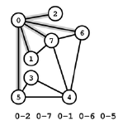
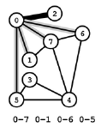
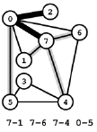
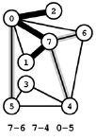
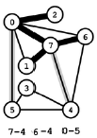
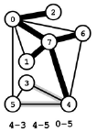
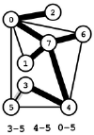
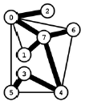
Prim’s Algorithms
Prim's algorithm. [Jarník 1930, Dijkstra 1957, Prim 1959]
Start with vertex 0 and greedily grow tree T. At each step,
add cheapest edge that has exactly one endpoint in T.

Slide 13
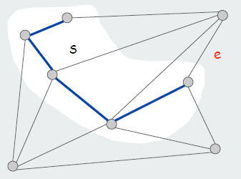
Prim’s Algorithms Concept
• Let S be the subset of vertices in current tree T.
• Prim adds the cheapest edge e with exactly one endpoint in S.
• e is in the MST (cut property)

Slide 14
Exercise 03
Find the minimal Spanning Tree of this graph start from a
8
7
b
b
c
c
d
d
4
2
9
4
14
i
a
i
e
11
e
8
7
6
10
h
g
f
h
g
f
Total is 37
1
2

Slide 15
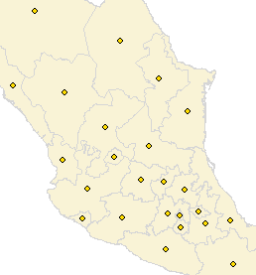
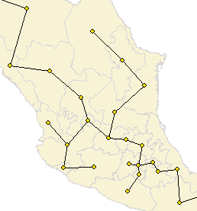
Exercise 04
Given N points in the plane, find MST connecting them

Slide 16
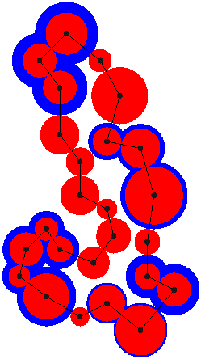
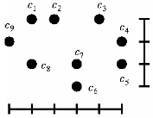
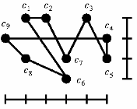
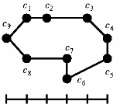
Traveling Salesmen Problem
Given a set of cities and that distance between each pair of cities, find the distance of a “minimum tour” starts and ends at a given city and visits every city
exactly once.

Slide 17
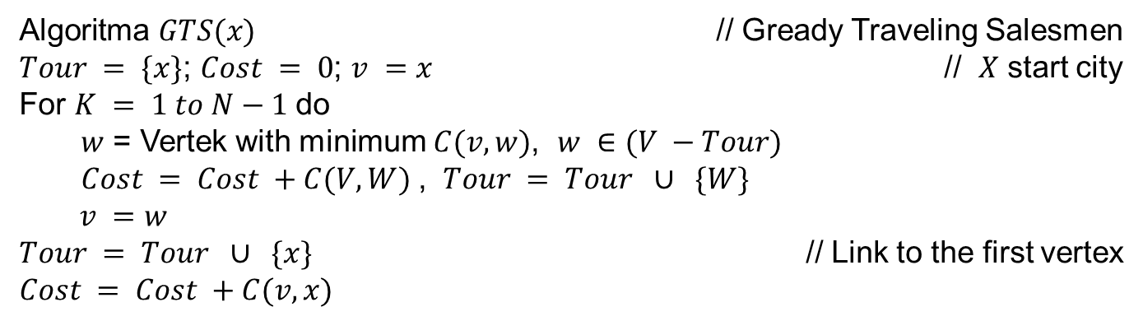
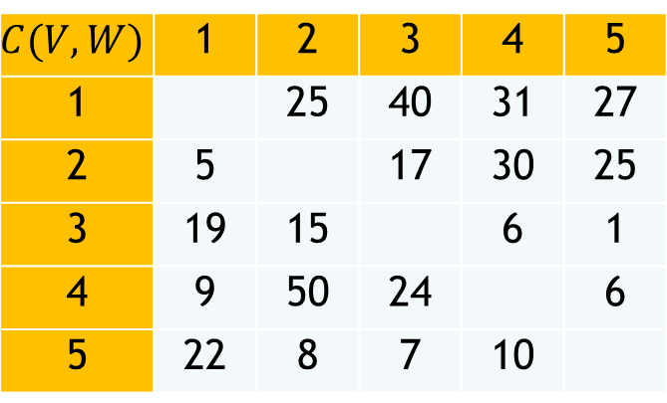
Example TSP
$$C(V,W)$$ | 1 | 2 | 3 | 4 | 5
1 |  | 25 | 40 | 31 | 27
2 | 5 |  | 17 | 30 | 25
3 | 19 | 15 |  | 6 | 1
4 | 9 | 50 | 24 |  | 6
5 | 22 | 8 | 7 | 10
1
5
2
4
3
Algoritma $GTS(x)$ // Gready Traveling Salesmen
$Tour = \{x\}$; $Cost = 0$; $v =x$ // $X$ start city
For $K = 1 to N−1$do
$w$ = Vertek with minimum $C(v,w)$, $w ∈(V −Tour)$
$Cost = Cost +C(V,W)$, $Tour = Tour ∪ \{W\}$
$v =w$
$Tour = Tour ∪ \{x\}$ // Link to the first vertex
$$Cost = Cost +C(v,x)$$

